Slide 1

#1
#2
Low Cost Modular Pick & Place Robot
FORT.HOSUR

Slide 2
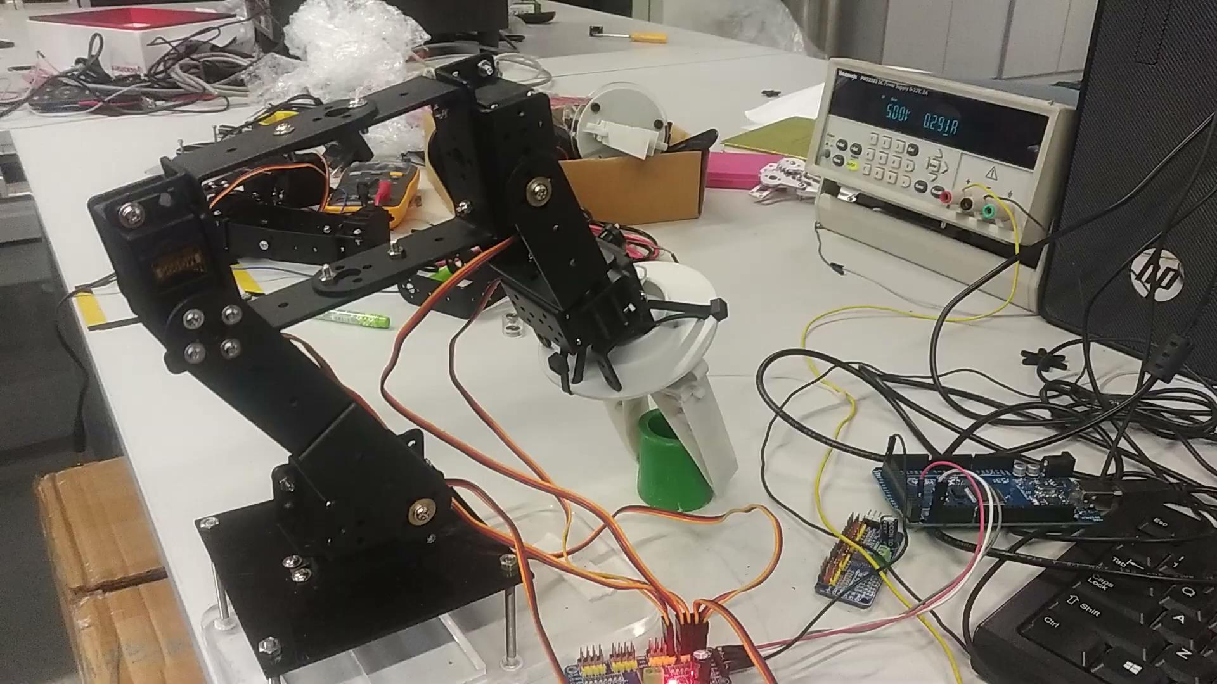
Milestone 1: Pick and Place by Bionic Gripper

Slide 3
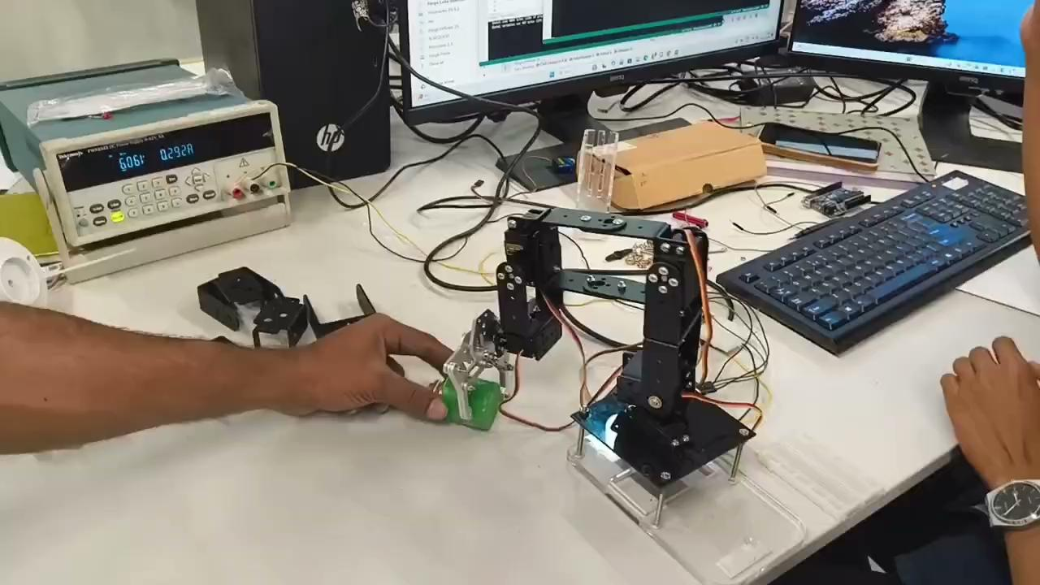
Milestone 1: Pick and Place by Metal Gripper

Slide 4
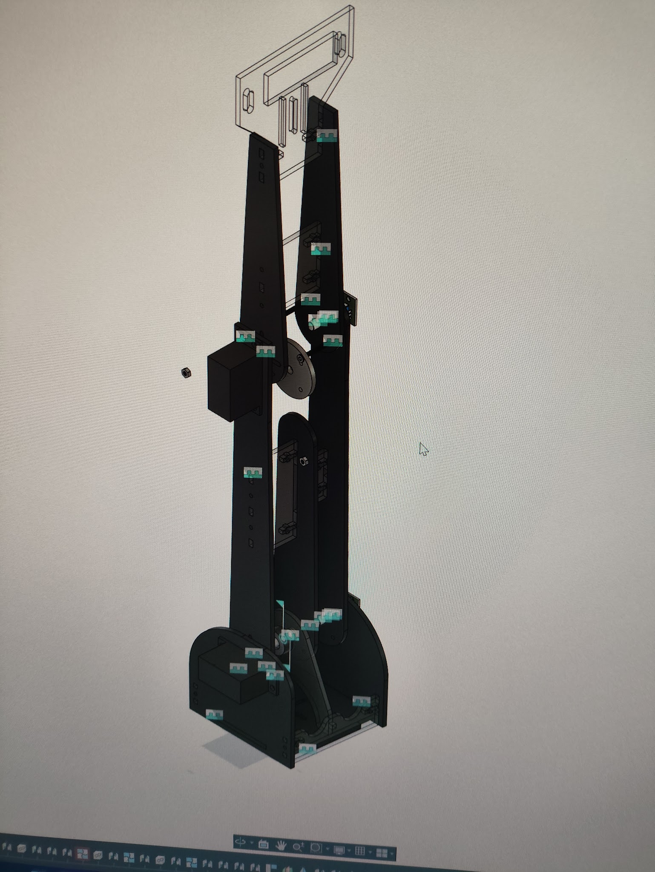
Milestone 2: Design of Robotic arm

Slide 5
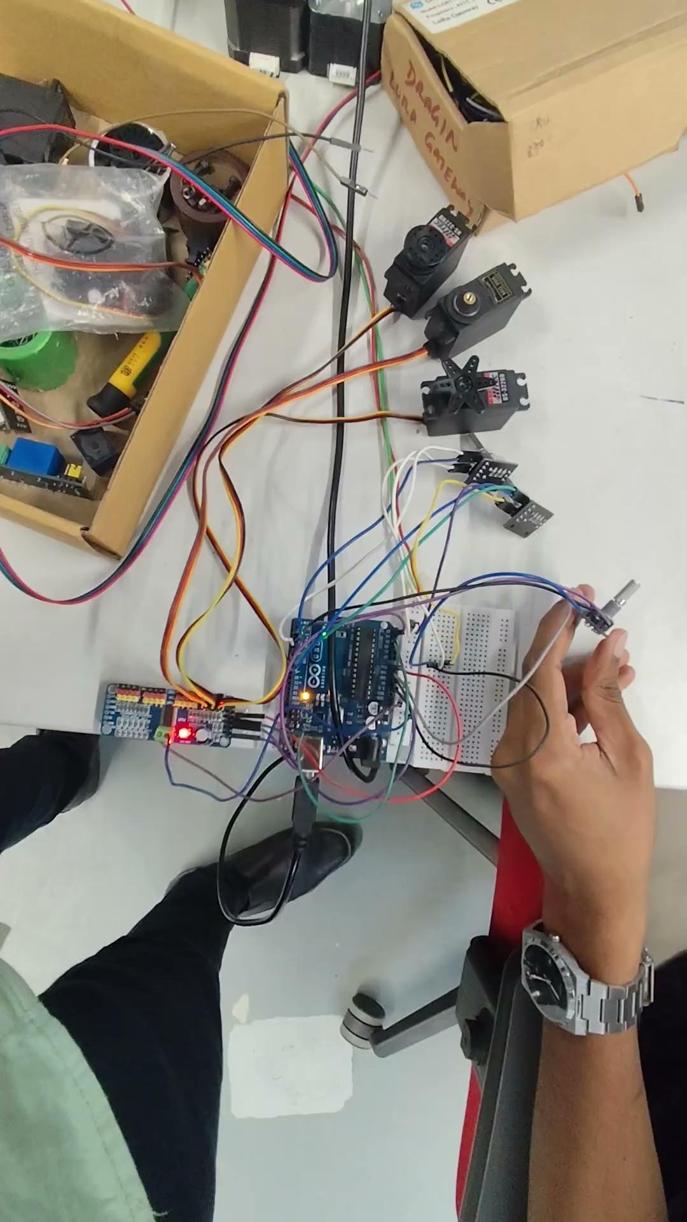
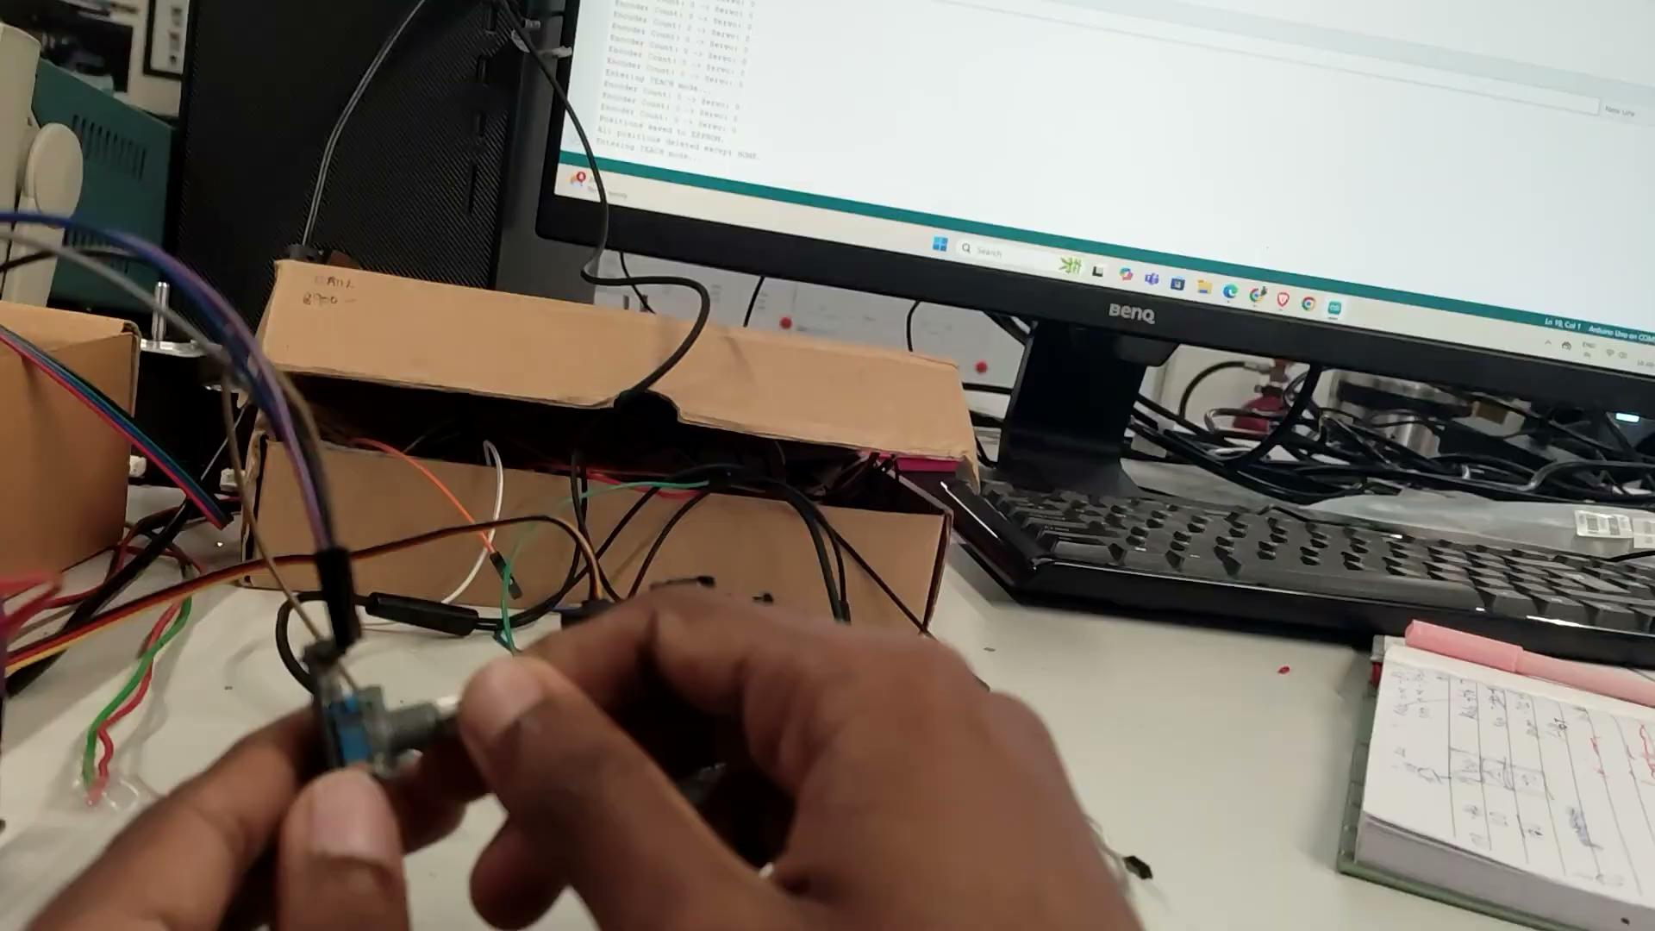
Milestone 3: Teaching by Rotary encoder

Slide 6
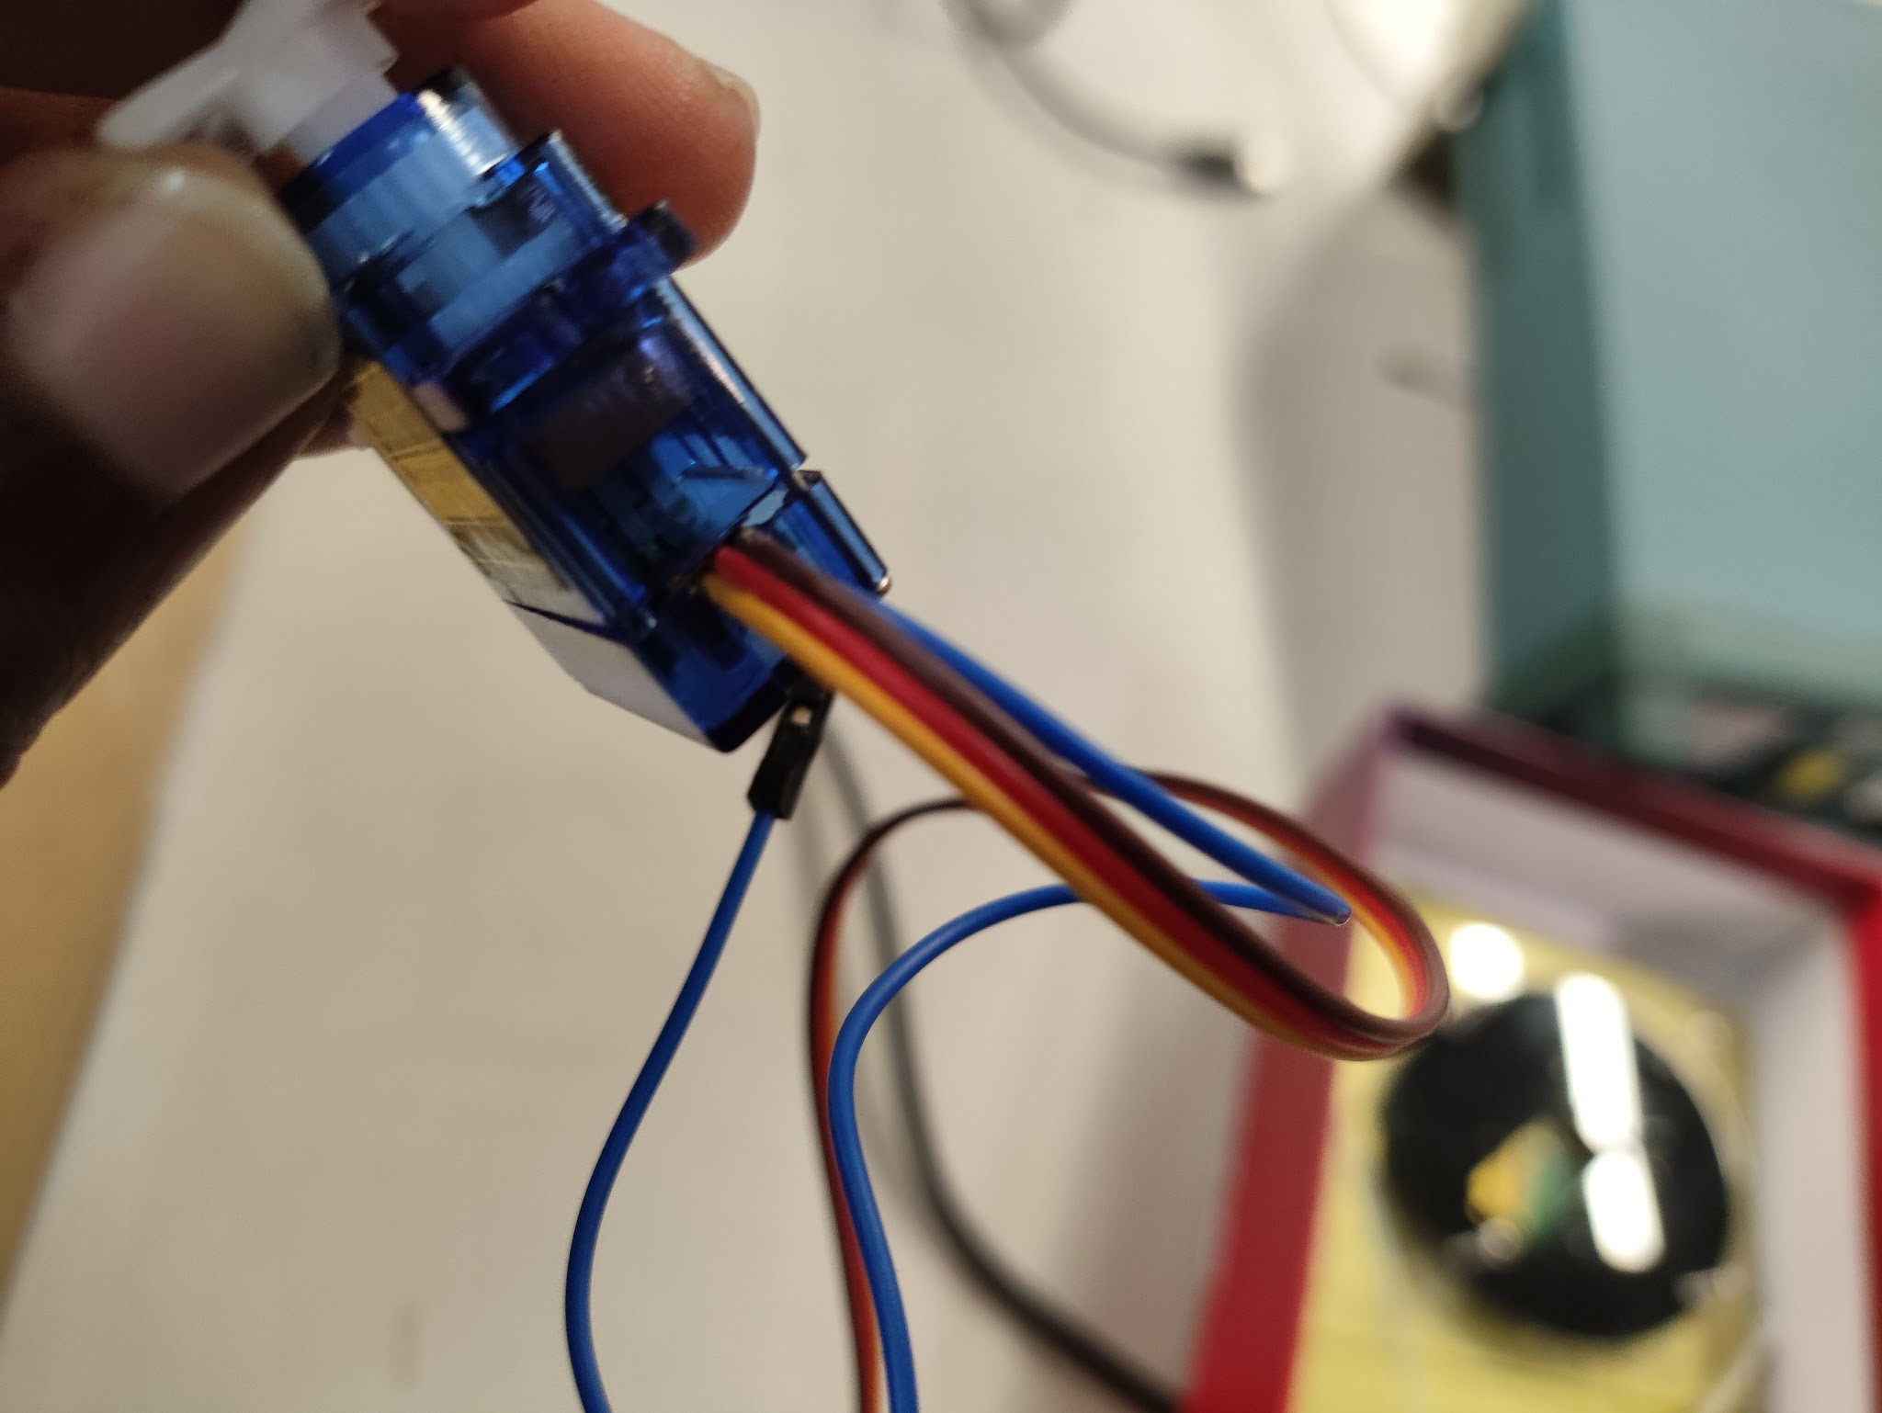
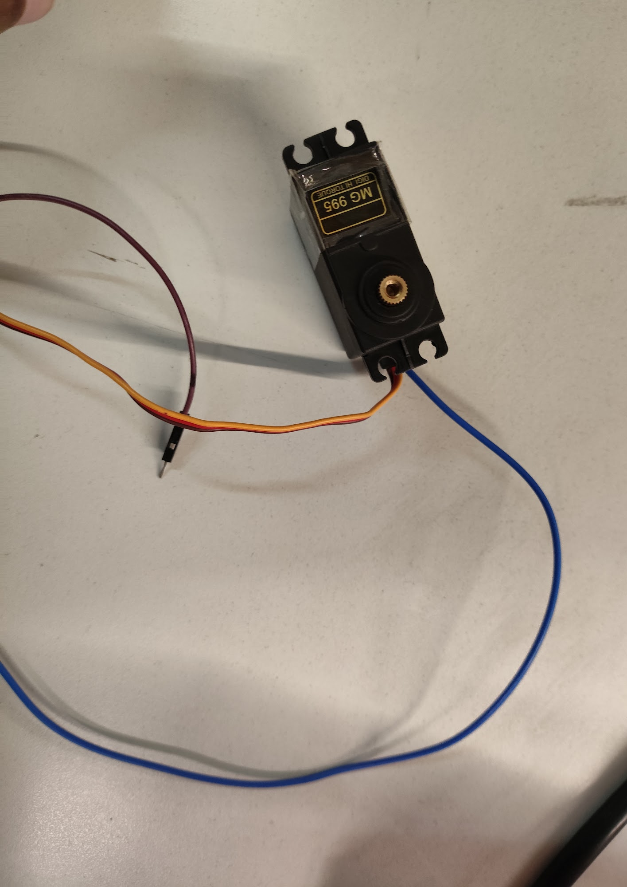
Milestone 3: Soldering inside of potentiometer for feedback

Slide 7
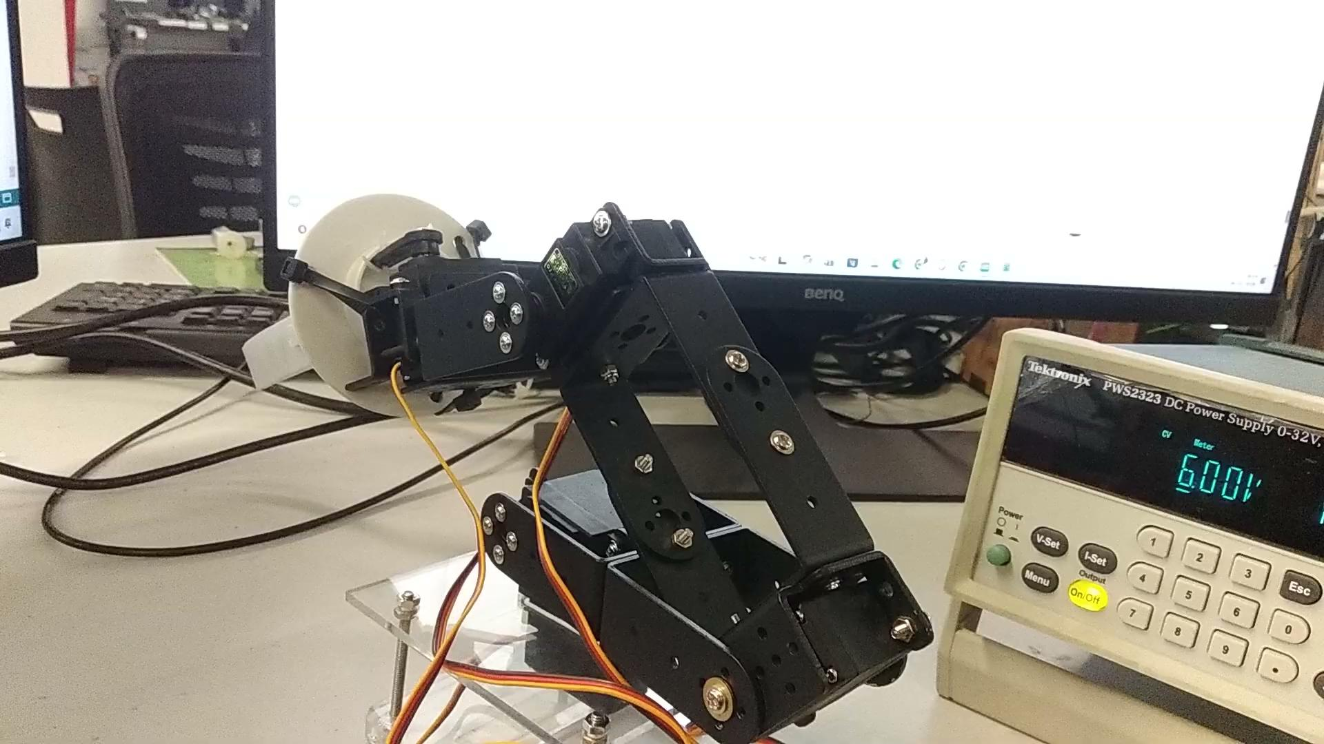
Milestone 3: Teaching by Serial Monitor

Slide 8
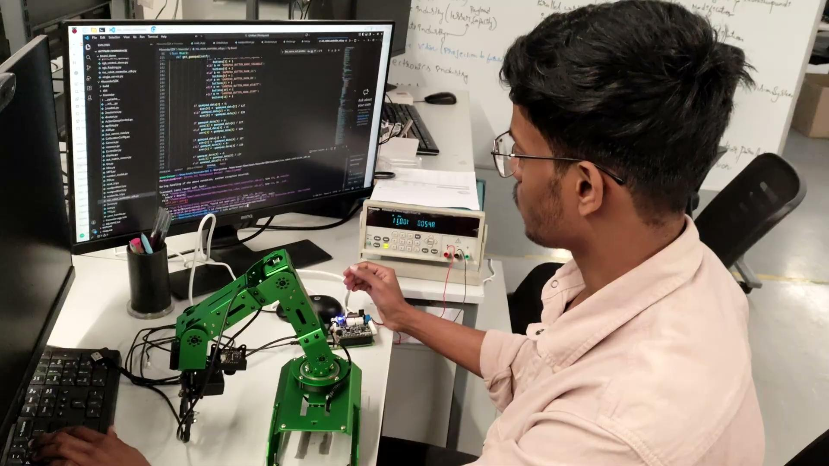
Milestone 4: Teaching by Manual Hand

